Slide 1
Independent Publishing Workshop
Pendelton C. Wallace
www.pennwallace.com
@pcwallace1
www.facebook.com/penn.wallace

Slide 2
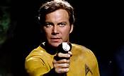
Set Your Cell Phones to “Stun”

Slide 3
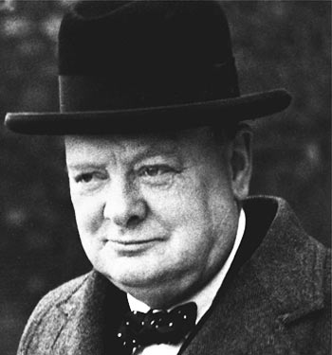
Never Give Up

Slide 4
Who Is Pendelton C. Wallace?
My friends call me Penn
I am not a writing expert (but I play one on TV)
I’ve worked long and hard to build my brand
This presentation is a result of what I’ve learned, but I’m just starting to see results
Currently have 7 books with next one due in October

Slide 5

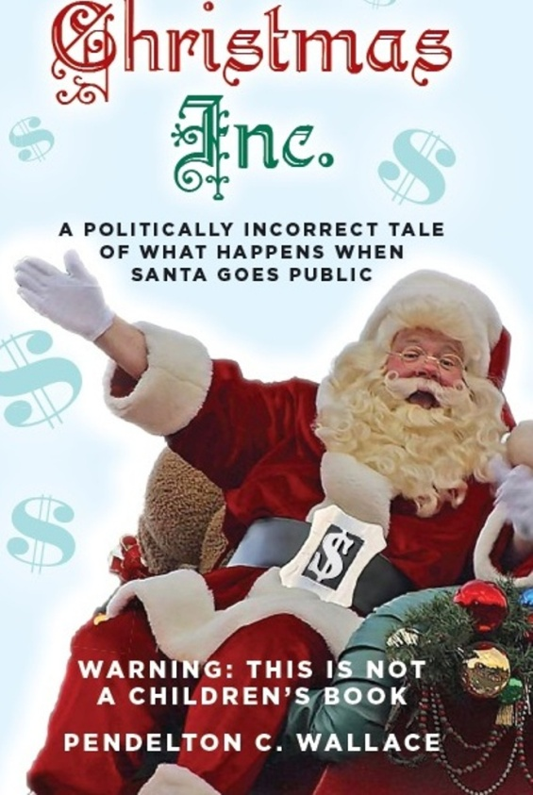
My Books

Slide 6

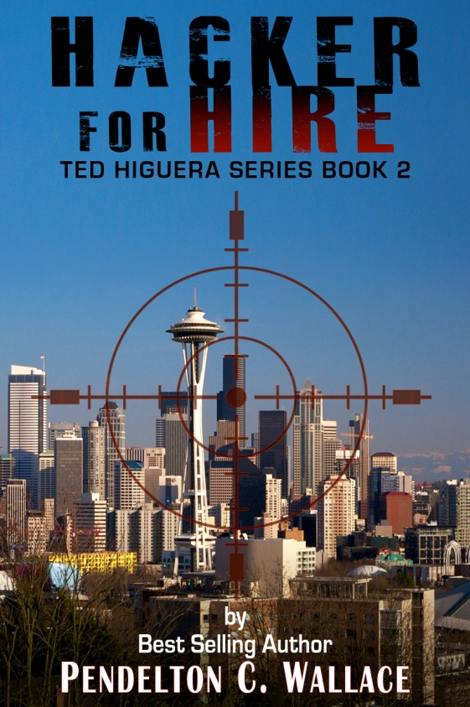


The Ted Higuera Series

Slide 7
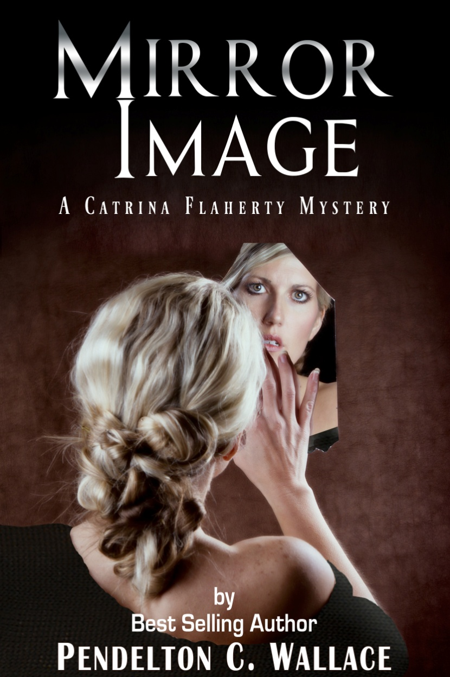
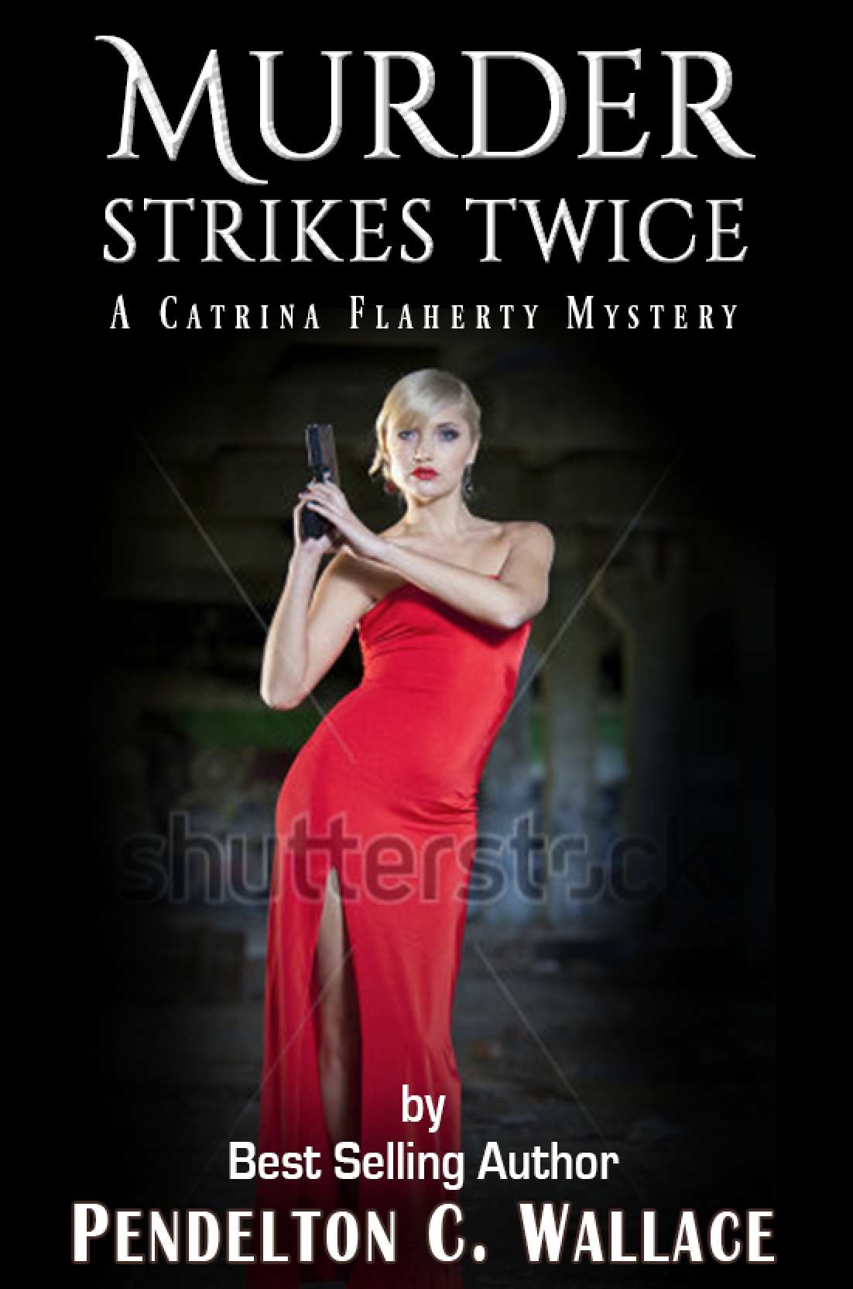
Catrina Flaherty Mysteries

Slide 8
The Unvarnished Truth
I don’t want to crush anyone’s dreams, but we’re talking about reality
  I know the dreams, I’ve been there myself
    Bidding war among publishers
    Best work of literature since Gone With the Wind
    Going to sell millions of copies
    Hollywood can’t wait
My reality was a little different
Sue Grafton’s speech
Writer story (Determination)
You must sell your own books

Slide 9
Why Do You Write
Passion – “I have to write”
Hobby
“I have a story I must tell”
To satisfy ego
To enjoy the “writing lifestyle”
To make money
Today we’ll talk about the business of writing
This session is for people who want to make a living writing
  Writing the book is 50% of the process
  Publishing the book is the other 50%
  Marketing the book is the final 50%

Slide 10
It All Starts With Good Writing
You must have a good product to sell
  Learn the components of a story and how to tell it before you try to publish
  Edit, edit, edit
  Your readers should not know or care that the book is an indie
You must have an interesting story
Know your target market (more on this in a minute)

Slide 11
The World Has Changed
When I first taught this class, it was about self-publishing with vanity presses.
    I warned authors that if you self-published, traditional publishers wouldn’t consider you
    Print a bunch of books, then fill your garage with them
  This was before the world of Create Space, eBooks and Print On Demand
  Now we are looking at a much different landscape.
  Hybrid authors
    Many indie authors have signed contracts with major publishing houses

Slide 12
How to Find an Agent
Stalking the wild agent
  Do your homework
  Query letters
  Go to conferences where there are agents
  Go to the intro to agents panel
  Note to whom you want to talk
  Go to their presentations
    Wait until all the people have left
    Introduce yourself
      Hi, I’m Pendelton Wallace. I’d like 30 seconds of your time to pitch my book. If you like it, we can talk for five minutes, if you don’t we can shake hands and part as friends and I’ll never bother you again.
    Have your best elevator pitch ready
        Write and re-write
        Share with you writers group
        Get expert opinions
        Practice until you drop

Slide 13
  Your Agent Pitches Your Book to Editors
They must be in love with your work
They know what editors handle what kind of books.
  My agent pitched book to 27 agents & 3 Hollywood studios
  When editor likes book, they pitch it to the editorial review board
    Editor must do a pro-forma on your book’s expected performance
    Compare to other books in the genre (give them comparables)
    Remember, this is a business
If ERB buys it, the agent gets to pitch it to publisher
  Publisher told editor to pitch my book to Barnes & Noble
Advances
      Usually in the $5000 neighborhood now
      Many authors never earn anything beyond their advance

Slide 14
So, A Publisher Bought Your Book
It usually takes about a year from signing contract to published book
  Endless rounds of editing
  Cover design meetings
  Pre-production
  You are one very unimportant cog on their conveyor belt

Slide 15
  Be Prepared for Disappointment
Rejections from Agents
  Don’t send you rejection letters anymore
Conflicts with publisher
  Publisher owns your work
    They choose title and cover
No one cares that you’ve published a book
  Between 200,000 and 1 million books published each year
  You must market the book
For every Shades of Gray or Dragons of Aragon there are a million Hacker for Hires

Slide 16
Self-Publishing
You are running your own business
Most indie books sell < 100 copies
I know people that have published books and then just expected them to sell
  They didn’t do too well
  What happens when you run out of family and friends?
  Most book stores won’t carry an indie book
    Some small, independent stores
    You must make personal contact with owners
    Usually carry on consignment
    You must take back any books that don’t sell
I don’t even bother printing copies of my books

Slide 17
  You Must Do Everything Big Publishing Houses Do
Write a great book
Find beta readers
Editing
Proof-reading
Interior design
Cover design
  Front cover
  Back cover
  Spine
  If you don’t know what I’m talking about you must hire a professional
Pre-publication publicity
Roll-out
Marketing

Slide 18
Why Choose One Over The Other?
  Traditional Publishing
    Pros
      Ego message from having publisher buy your book
      The publisher does all (most of) the work
      “Legitimate” author.
      You get an advance
    Cons
      You lose control of your book
        Publisher may change name
        May insist on changes you don’t want
        May put your book on back burner
      Don’t market your work
      Smaller share of sales
      Must split royalties with agent
      Publisher can drop you at any time
        You work goes out of print

Slide 19
Why Choose One Over The Other?
    Indie Publishing
      Pros
        You control your work
        Larger share of sales
        Creative freedom
        Fewer obstacles
        No gatekeepers
      Cons
        You are responsible for everything
        If you can’t do it yourself, you must hire someone who can
        It’s a gamble - All expenses up front
          You may or may not make your money back
        You will spend more time marketing than writing

Slide 20
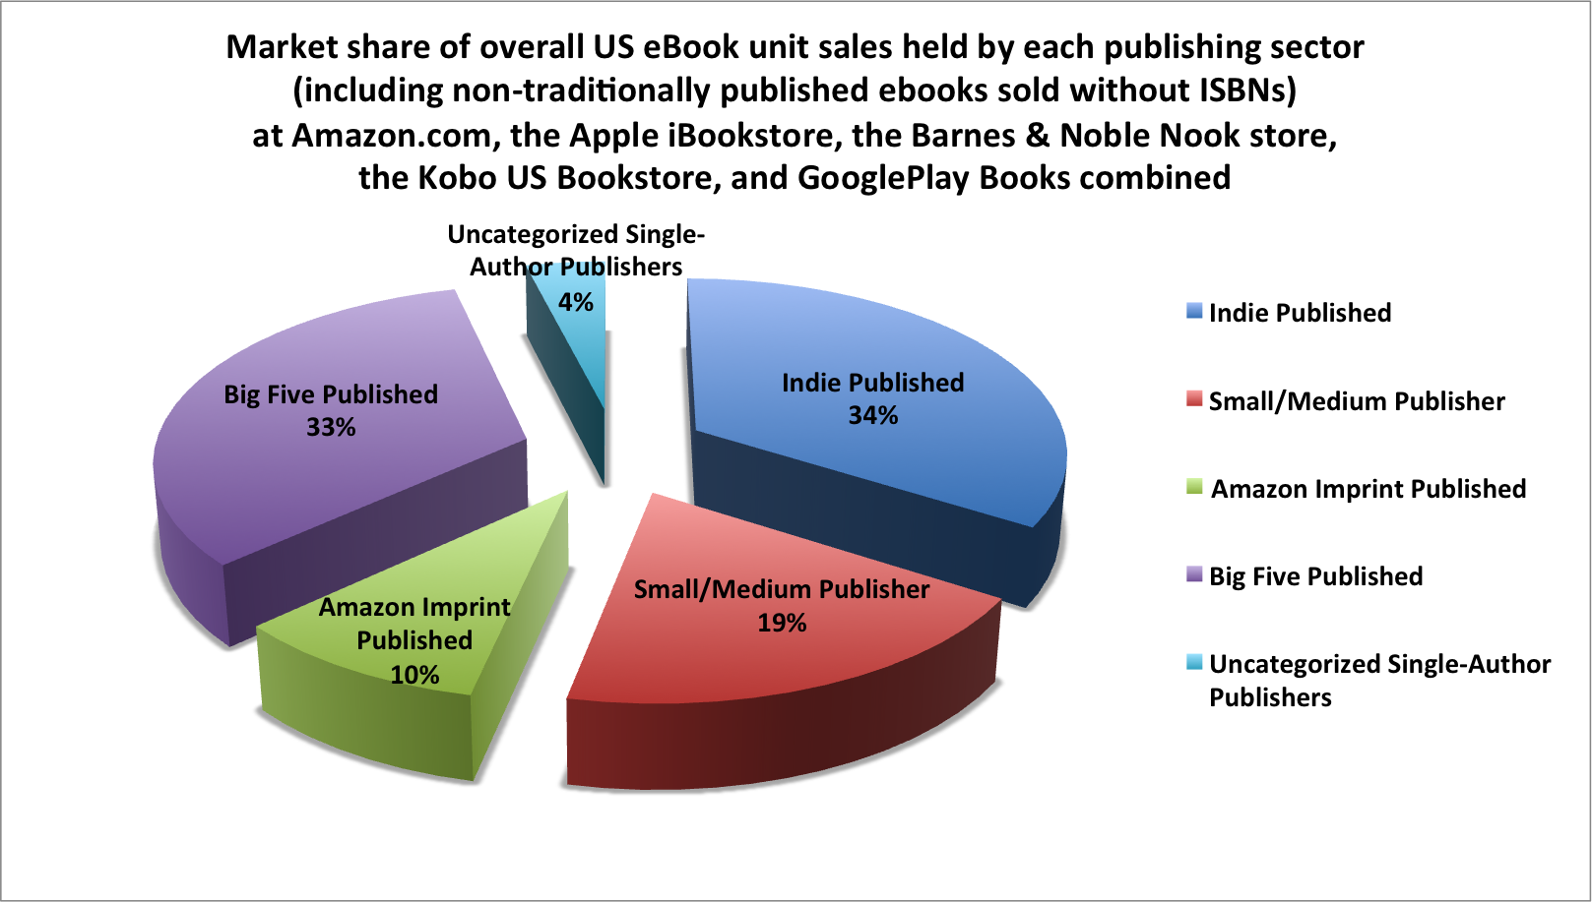
Over All U.S. Market Sales

Slide 21
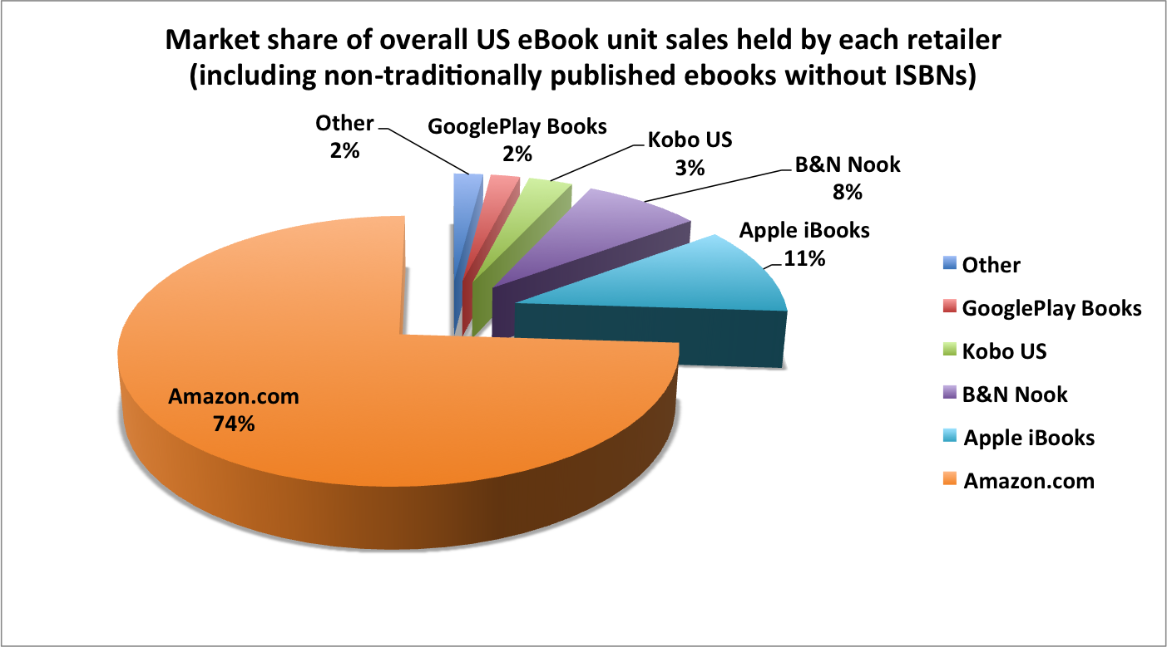
U.S. eBook Sales by Retailer

Slide 22
Indie Publishing Options
Create Space
Kindle Direct Publishing
iUniverse
Many others
All are willing to take your money
  Research carefully
  Ask other authors on Facebook groups and forums
  (You ARE on Facebook, aren’t you?)

Slide 23
Know Your Target Market
Who will want to read your book?
  Why will they like it?
  Where will you find them?
  What values do you have in common?
  What will they find compelling about your book?
How can you reach them?
  Christian book – church groups
  Sailing book – yacht clubs, boat shows
  Dog book – dog shows, dog magazines, social media
  YA book – social media
How I discovered my target market

Slide 24
Social Media
Drive potential readers to your Web site
FaceBook
Twitter
LinkedIn
Google+
What’s next???
Two hours a day

Slide 25
Indie Publishing Tips
You need five titles to make e-marketing work – Preferably a series
If you’re an Indie, wait until you have 3 books ready to publish
Roll out book every 3 months
Keep writing and write fast
Let readers see you and your characters evolve
New books drive old book sales
Find most effective ways to promote your books

Slide 26
Indie Publishing Tips
If you have hard copy books, personal appearances are best way to sell
  Doesn’t work to well with ebooks
  You don’t have anything to sell them on the spot
Get creative
  Do joint appearances
  Promote, promote, promote
    People won’t show up just because you are doing a reading
    How can you reach people and get them to show up?
  Adventures by the Book
  Anthologies

Slide 27
Most Important Marketing Tools
Book cover
  People do judge a book by its cover
  You must grab their attention enough on a thumb-nail to get them to click on your book
Fan mailing list
  Your most ardent supporters
  The actually WANT you to succeed
  They will champion you and help you with your books and marketing

Slide 28
Build A Fan Mailing List
One of your most important marketing tools
  These are your most important readers
  Guaranteed buyers
  Give them great deals
Put your contact information in back of book
Personally reply to every email
Built a rapport with fans
Answer criticisms politely and courteously
Send them personal emails with writing news
Give Aways are great

Slide 29
Reviews
The life-blood of your business
Readers check reviews before making the buying decision
How can you get reviews?
  Jump Start Your Book Promotion
    http://www.amazon.com/Jump-Start-Your-Book-Promotions-ebook/dp/B00HZ2RM70/
  Free review sites
  Facebook groups
Paid review sites
Ask in back of your book
Advance Review Copies (ARCs)
Run contest

Slide 30
Post Script
(The Mexican Connection)
I hope you enjoyed your little foray south of the border.
Reviews are the life blood of independent writers. I need
your reviews to give my work credibility and convince new
readers to take a chance on an unknown author. If you liked
the book, I ask you to write a review of The Mexican
Connection on Amazon.com, Goodreads or where ever you
go for your book information. Thank you so much, it means
the world to me. If you didn’t like the book, then please
disregard this paragraph.
I’d love to hear your comments and criticisms. Who knows,
maybe some of your ideas will appear in a future Ted Higuera
novel. To contact me click here or use the Contact Penn form on
my web site at www.pennwallace.com.

Slide 31
Review Contest
Bikini Baristas
  I’m going to sweeten the pot here a little bit. If you post your review in the first week Bikini Baristas is available, I’ll enter your name in a drawing for a thriller package. I will send you four thrillers by other authors that I admire. I’ll also throw in an Amazon.com gift certificate for $40. Just send me an email with a link to your review and your address. We’ll hold the drawing on August 17th, 2015, will notify the winners immediately and send the prizes via Amazon.com.

Slide 32
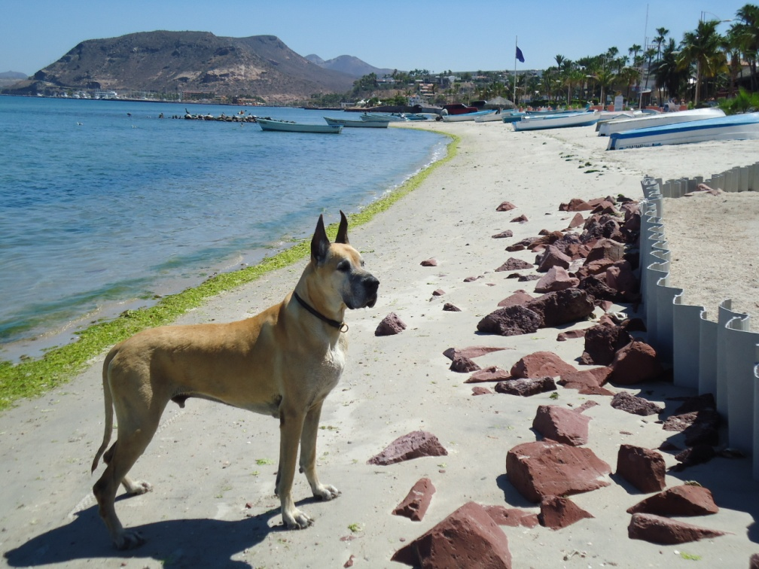
Put a Dog in Your Book
Jinx Schwartz
Robert the Bruce in The Inside Passage
Popo in Bikini Baristas
Dog Books
  The Art of Racing in the Rain –Garth Stein
  Marley and Me – John Grogan
People are suckers for dogs

Slide 33
What Other Successful Indie Authors Say
Wayne Stinnett - Publish the first book and forget about it. No amount of networking or advertising sells a first book better than a second one.
Mickel Miller - I'm old school, so I still believe content is king despite some self-published authors who manage to sell books of crap content on Amazon. My advice to wannabe indie authors itching to self-publish is to read a couple of good books about writing, especially "On Writing Well" by William Zinsser and "On Writing" by Stephen King. Spend six months or a year rewriting drafts and asking for feedback from successful indie authors. Then hire a professional editor and a professional proofreader before self-publishing -- DO NOT rely on friends and family. Waaaay too many writers self-publish content with poor writing and obvious errors.

Slide 34
What Other Successful Indie Authors Say
  John Scherber – An American Voice in Mexico - Self-publishing is the open door of the 21st century. Walk through it upright. It will bar no one based on gender, age, IQ, country of origin, religion, politics, or any other qualification, even quality of writing. If you believe you are the victim of gender bias in the publishing industry, DO NOT USE THEM. They don’t care about you anyway. In this regard, they have no bias at all, because they don’t care about anyone but themselves. Why pay them 89% of your royalties and yield all control in the process? –www.sanmiguelallendebooks.com

Slide 35
Blogging
This is where you sell your books
Don’t write too frequently
Become OOT (One of Them)
Write to your target market
Loyalty transfer
  John Locke’s blog
Write from the heart
Don’t let it slip away from you

Slide 36
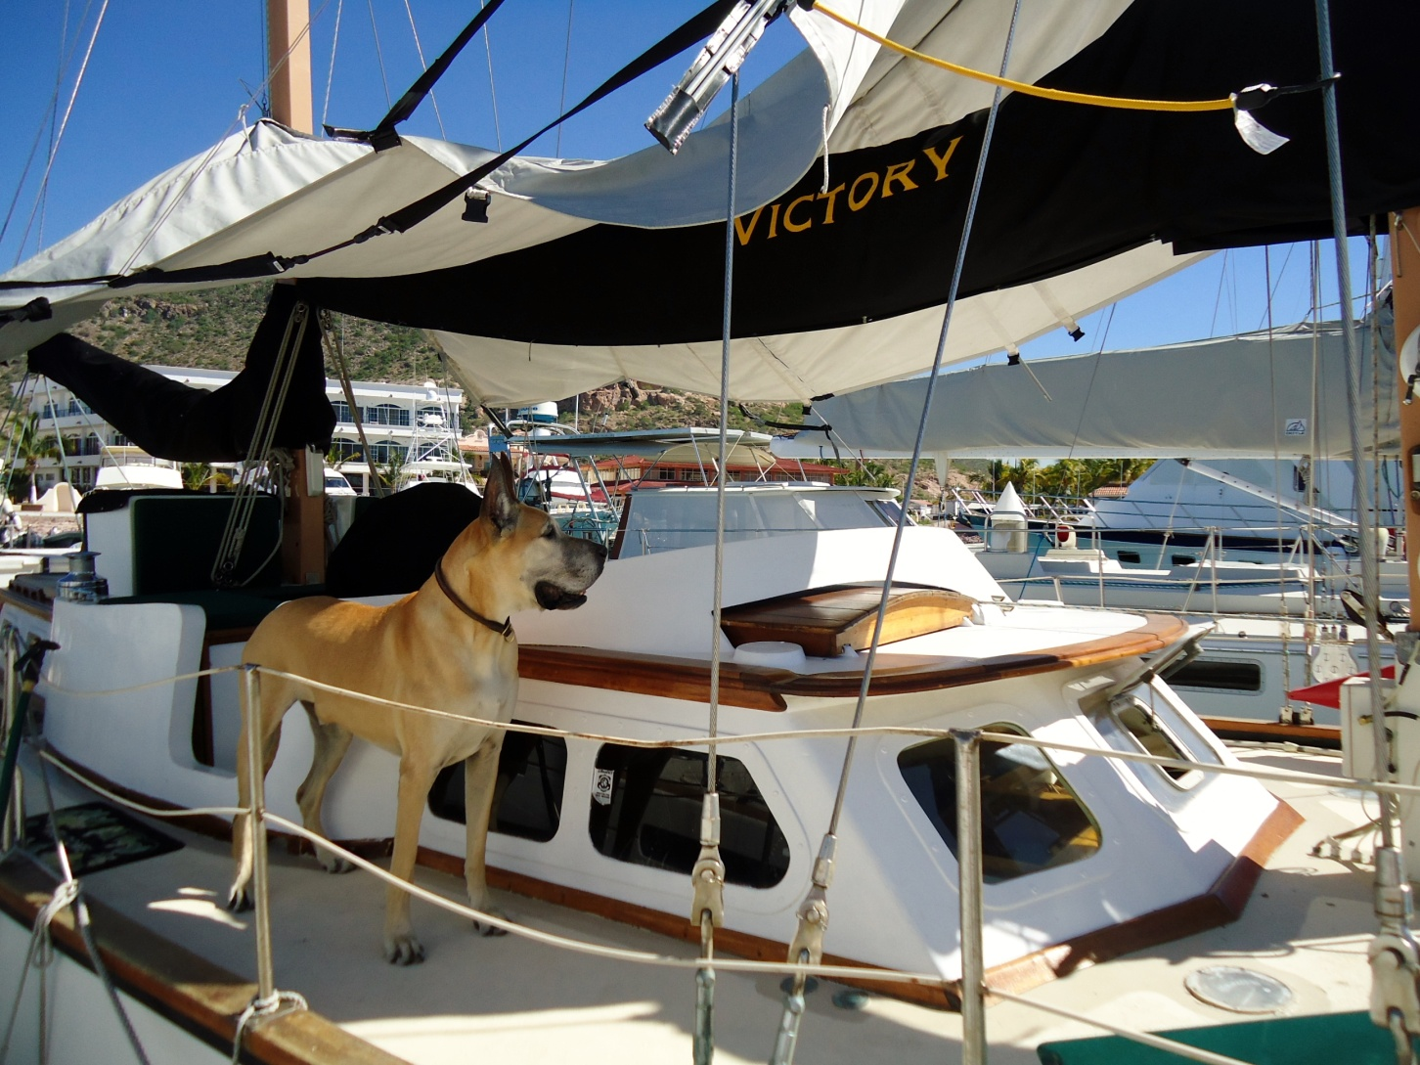
Great Dane on Board

Slide 37
Personal Appearances
#1 way to drive (hard copy) sales
Book publishing party
Readings
Book signing parties
Book Clubs
Find your natural market
  Yacht clubs
  Marine stores
  Latino events
  Writers conferences

Slide 38
Never Give Up
Did I already say this?
You have to blow your own horn
You can’t wait for the market to find to you
Hard work and elbow grease
Don’t ever stop trying
Keep writing
  New books drive old book sales

Slide 39
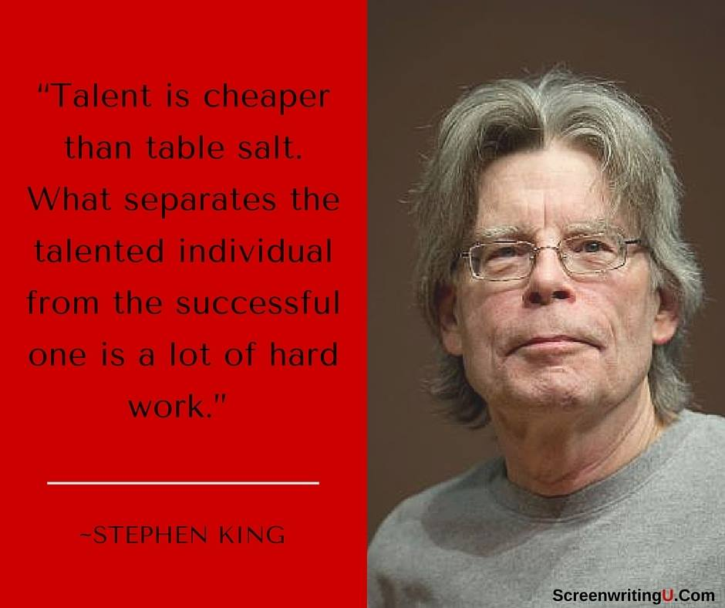
Another Author You May have Heard Of

Slide 40
The Strangest Secret
Earl Nightingale
Successful people routinely do things that they don’t enjoy

Slide 41
Marketing Walk-a-Way
One of the most successful marketing ideas of all time
Salesman doubled his sales and changed the industry
Wash-Rinse-Repeat
If you want to learn more about marketing, ask SDWI to host my Marketing 101 seminar

Slide 42
Let’s Stay in Touch
www.pennwallace.com
penn@pennwallace.com
Sign up for my readers list
  Giving away a copy of Mirror Image for everyone who signs up until December
Watch for my other classes at writers conferences
  http://www.pennwallace.com/contact-list-landing-page.html

Slide 43
Seminar Materials
On my website at www.pennwallace.com
Click on “More”
  Click on “Writer’s Stuff”
There’s a whole wad of things to help writers
  Collaborative Indie Publishing
  The Beat Sheet
  Character Sketch Template
  Marketing Plan Template
  Writers Journey Outline
  Marketing 101 Outline
  Marketing 101 PowerPoint
  Critique Groups
  Critique Groups PowerPoint

Slide 44
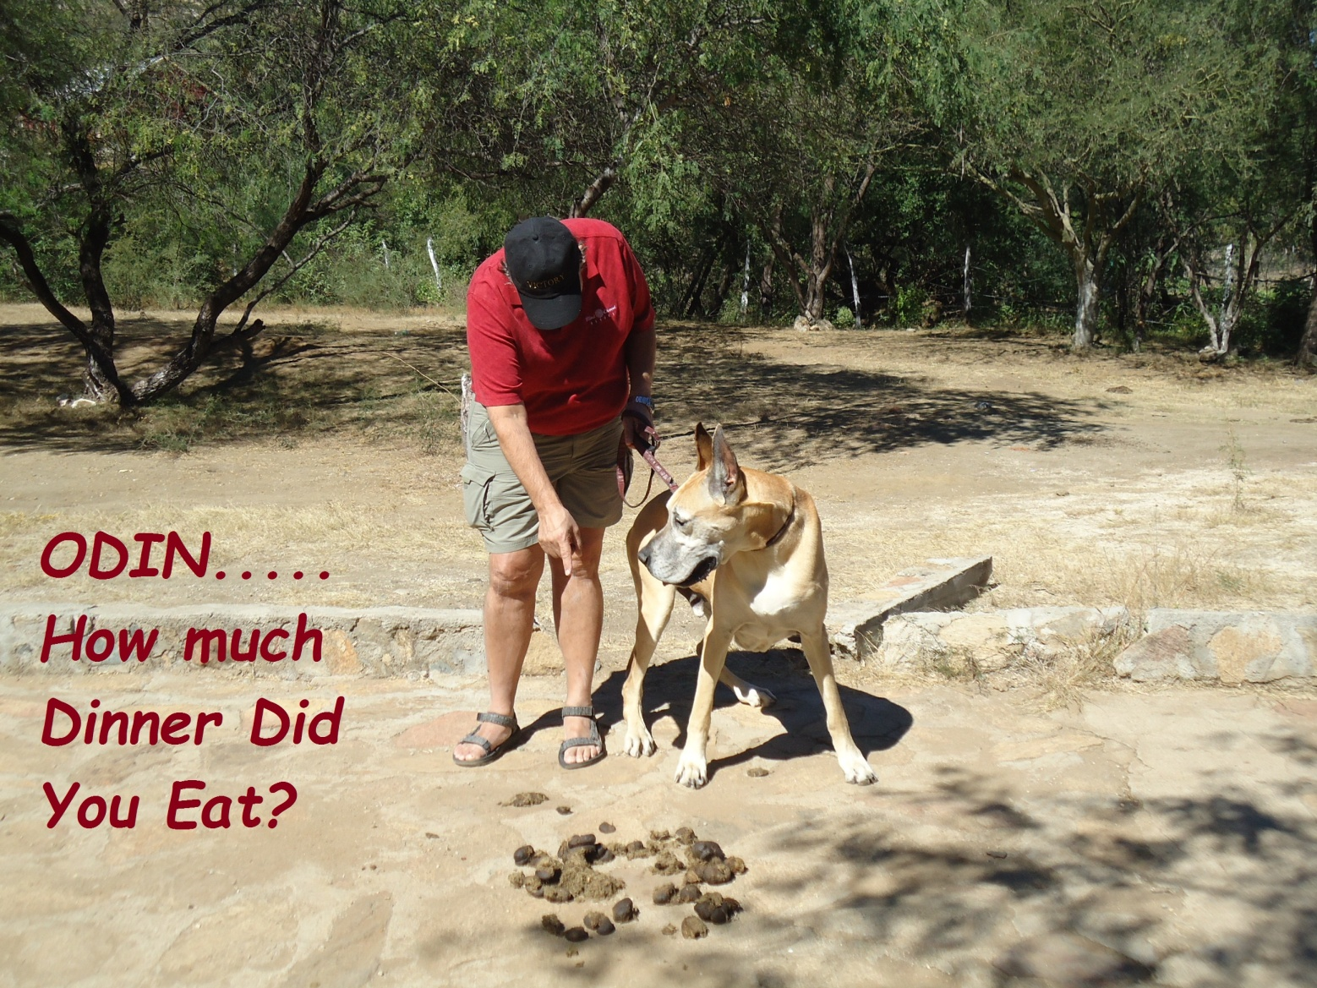
Questions ?

Slide 45
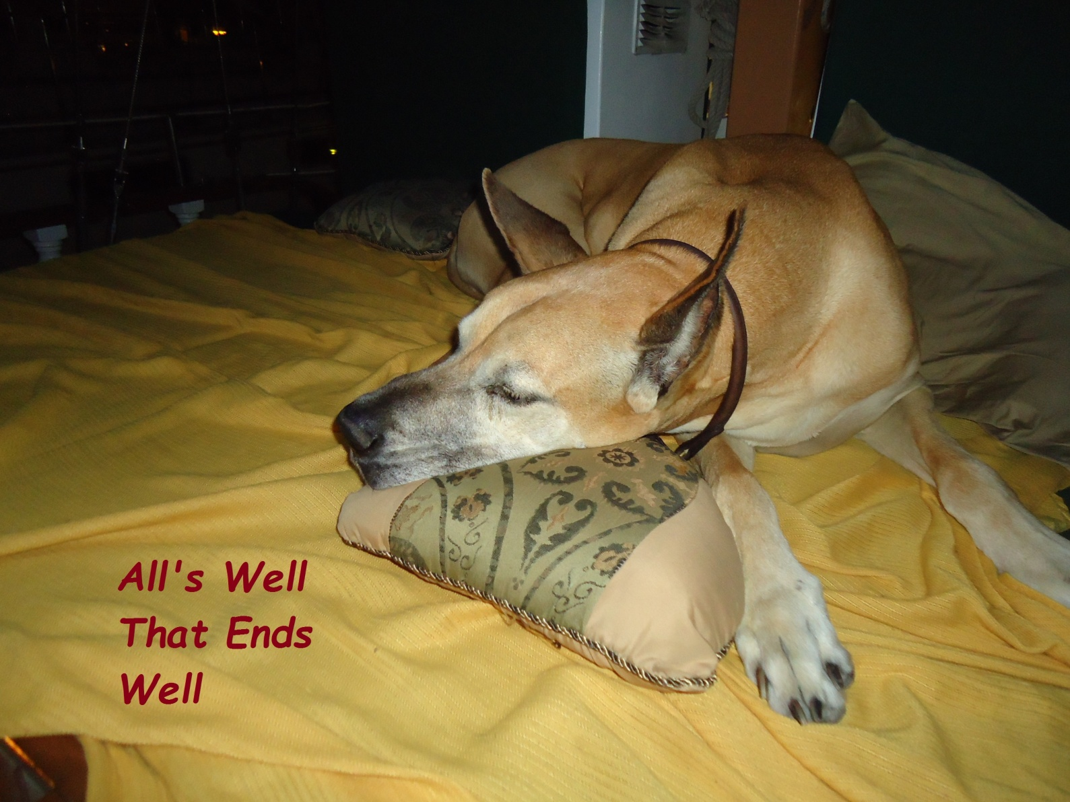
Thank You www.pennwallace.com

