Slide 1
Marketing 101
Penn Wallace
www.pennwallace.com
@pcwallace1

Slide 2
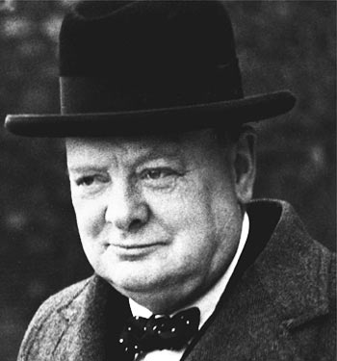
Never Give Up

Slide 3
Marketing 101
I am not a marketing expert (but I play one on TV)
I’ve worked long and hard to market my books
This presentation is a result of what I’ve learned, but I’m just starting to see results
Currently have 5 books with next one due in spring

Slide 4

Blue Water & Me

Slide 5
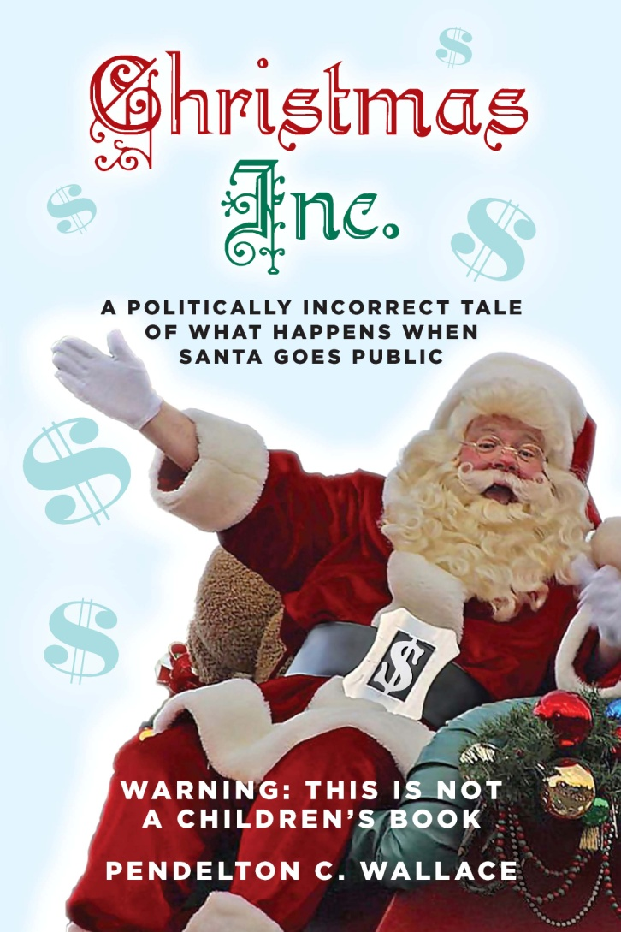
Christmas Inc.

Slide 6

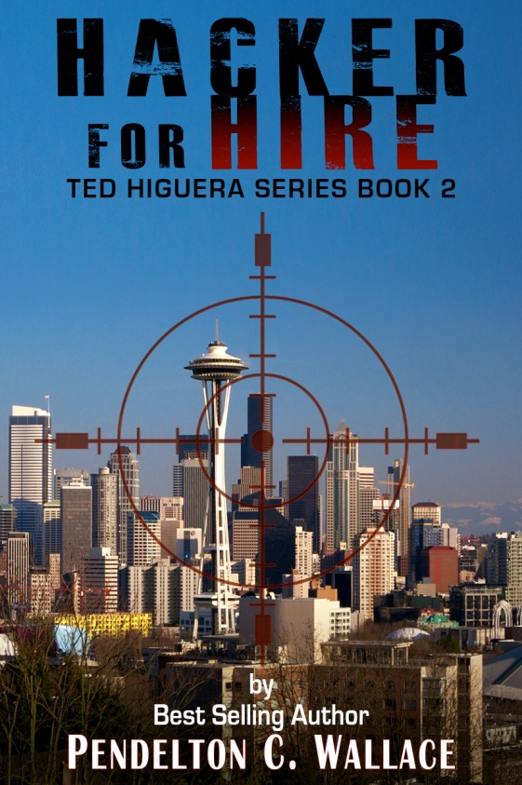

The Ted Higuera Series

Slide 7

Seven Seas Mysteries

Slide 8
Why Do You Write
Passion – “I have to write”
Hobby
“I have a story I must tell”
To satisfy ego
To make money
Today we’ll talk about the business of writing
This session is for people who want to make a living writing

Slide 9
It All Starts With Good Writing
You must have a good product to sell
You must have an interesting story
Know your target market (more on this in a minute)

Slide 10
It All Starts With Good Writing
Many of the indie novels available on Amazon are first draft quality
We must police ourselves if we want the reading public to take us seriously
Producing a good product is not cheap
  Hire a professional editor
  Hire a professional proof reader
  Professional cover design
  Interior Formatting

Slide 11
Your 2 Most Important Marketing Tools
The Cover
  Must make reader pick up book and read the back cover description
The Hook (the first line)
The Salinas Valley is in Northern California. It is a long narrow swale between two
ranges of mountains, and the Salinas River winds and twitss up the center until it
Falls at last into Monterey Bay.
The trawler plunged into the angry swells of the dark, furious sea like an
awkward animal trying desperately to break out of an impenetrable swamp.
To the public eye, the spouses of well-known writers are all but invisible,
And no one knew it better than Lisey Landon.

Slide 12
Your 2 Most Important Marketing Tools
The Salinas Valley is in Northern California. It is a long narrow swale between two ranges of mountains, and the Salinas River winds and twists up the center until it falls at last into Monterey Bay. – East of Eden, John Steinbeck
The trawler plunged into the angry swells of the dark, furious sea like an awkward animal trying desperately to break out of an impenetrable swamp. – The Bourne Identity, Robert Ludlum
To the public eye, the spouses of well-known writers are all but invisible, and no one knew it better than Lisey Landon. – Lisey’s Story, Stephen King

Slide 13
Know Your Target Market
Who will read your book?
Why will they like it?
What values do you have in common?
How can you reach them?
What will they find compelling about your book?
Where will you find them?

Slide 14
eBook Marketing Secrets
You need five titles to make e-marketing work
If you’re an Indie, wait until you have 3 books ready to publish
  Roll out book every 3 months
  Keep writing and write fast
Let readers see you and your characters evolve
Put a dog in your book
New books drive old book sales
Find most effective ways to promote your books

Slide 15
Be an Overnight Sucess
For every Shades of Gray or Dragons of Aragon there are a million Hacker for Hires
It only takes about 5 years

Slide 16
My Five-Year Plan
Publish Christmas Inc. in 2013 to create stir
Publish five Ted Higuera books in first two years
New blog entry every 2 weeks
Keep website up to date and relevant
Roll out book every 3 months in 2014
Run BookBub.com promos every month
Produce 2 Ted Higuera novels in 2015
Publish hard copy versions in 2015
Write dog story in 2015
Start another mystery series in 2016
Publish 3 new mystery series novels by 2017

Slide 17
Write a Marketing Plan
Make a plan, stick to the plan
  If the plan’s wrong, change the plan
Track your sales
  Where do they come from?
  What causes your sales to blip?
  Do more of this kind of marketing
Be consistent across all your platforms
Start early
You can’t do it all by yourself
Outline available at www.pennwallace.com

Slide 18
Organize a Marketing Committee
Find people who will work for you
  Contacts are important
    Media
    Libraries
    School systems
    Corporate contacts
Brainstorm – but you must put ideas into action
Write marketing plan outline before you begin
Meet on a regular basis
Keep the momentum going

Slide 19
Your Web Site
Don’t have one? – Get one
  Most important marketing tool you have
Build a bond with your readers
Keep it current
  Give your readers a reason to keep coming back
Special offers, contests, etc
Writing samples
  Character sketches
  Sample chapters
  Short stories
  Show your style
Ask for the sale

Slide 20
Sample Web Sites
http://donnamiscolta.com/
http://www.clydeford.com/
http://bernardcornwell.net/
www.pennwallace.com

Slide 21
Media Kit
Author Bio
Q&A
Press Release
Marketing Strategy
Why is your book relevant?
How to use media kit

Slide 22
Social Media
Drive potential readers to your Web site
FaceBook
Twitter
LinkedIn
What’s next???

Slide 23
Build An Email List
One of your most important marketing tools
  These are your most important readers
  Guaranteed buyers
  Give them great deals
Put your contact information in back of book
Personally reply to every email
Built a rapport with fans
Answer criticisms politely and courteously
Send them personal emails with writing news

Slide 24
Post Script
(The Mexican Connection)
I hope you enjoyed your little foray south of the border.
Reviews are the life blood of independent writers. I need
your reviews to give my work credibility and convince new
readers to take a chance on an unknown author. If you liked
the book, I ask you to write a review of The Mexican
Connection on Amazon.com, Goodreads or where ever you
go for your book information. Thank you so much, it means
the world to me. If you didn’t like the book, then please
disregard this paragraph.
I’d love to hear your comments and criticisms. Who knows,
maybe some of your ideas will appear in a future Ted Higuera
novel. To contact me click here or use the Contact Penn form on
my web site at www.pennwallace.com.

Slide 25
Blogging
This is where you sell your books
Don’t write too frequently
Become OOT (One of Them)
Write to your target market
Loyalty transfer
John Locke’s blog
Write from the heart
Great Dane on Board
Don’t let it slip away from you

Slide 26
Personal Appearances
#1 way to drive (hard copy) sales
Book publishing party
Readings
Book signing parties
Book Clubs
Find your natural market
  Yacht clubs
  Marine stores
  Latino events
  Writers conferences

Slide 27
Never Give Up
Did I already say this?
You have to blow your own horn
You can’t wait for the market to find to you
Hard work and elbow grease
Don’t ever stop trying
Keep writing
  You need five titles to make e-marketing work
  This is why you got into the game
  Let readers see you and your characters evolve
  New books drive old book sales

Slide 28
The Strangest Secret
Earl Nightingale
Successful people routinely do things that they don’t enjoy

Slide 29
Thank You www.pennwallace.com

