Slide 1
Writers Critique Groups
Pendelton C. Wallace
www.pennwallace.com
San Diego State University Writers Conference
January 23-25, 2015

Slide 2

Captain Penn Wallace
Been writing 12 years
Been in several writing groups
Learned what does and doesn’t work for me
Presented this workshop several times at various conferences
Published 5 books
Next book due out this summer

Slide 3


Two Unrelated Books

Slide 4



Ted Higuera Series

Slide 5

Seven Seas Mysteries

Slide 6
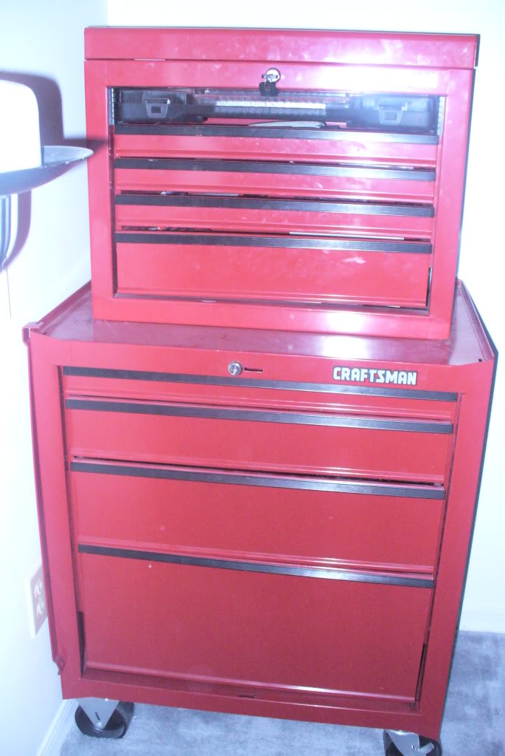
The Most Important Tool in your Tool Box
Try to find people who are better/more experienced than you
It’s like playing tennis, you only get better by playing with better players
Have thick skin

Slide 7

Why Do You Want to be in a Critique Group?
Mutual support
Learn and grow as a writer
Social
Help other writers

Slide 8
What Can a Critique Group do For You?
Provide deadline to keep you working
Motivation and Inspiration
You get quick and easy feedback
Critiquing other’s writing helps you understand what works and what doesn’t
Meet and make friends with local writers

Slide 9
What a Critique Group Can’t do For You
Provide validation
    Don’t expect to be told you’re a great writer
    Don’t expect to be told how to become a great writer
Line editing
    Group should focus on theme, clarity, character development, flow, etc
Proof you have talent
    Talent is over rated
A place to vent frustrations

Slide 10
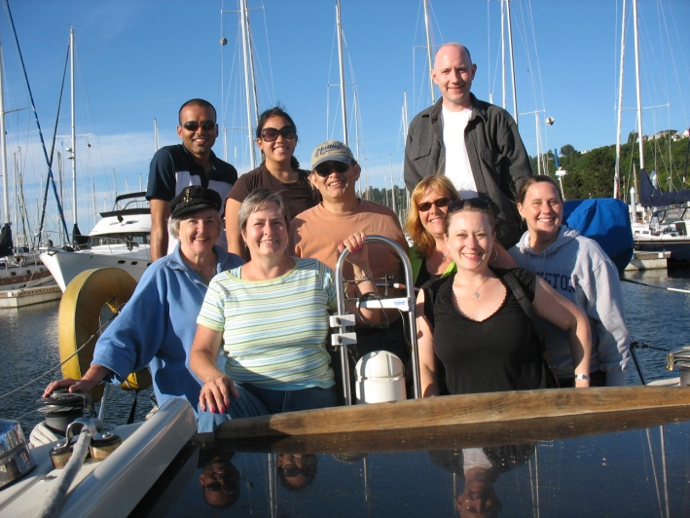
How Our Group Works
2500 words every two weeks (I’d prefer weekly)
Sent your submission by Sunday for Wednesday meeting
Edit and critique work on paper before you come to meeting

Slide 11
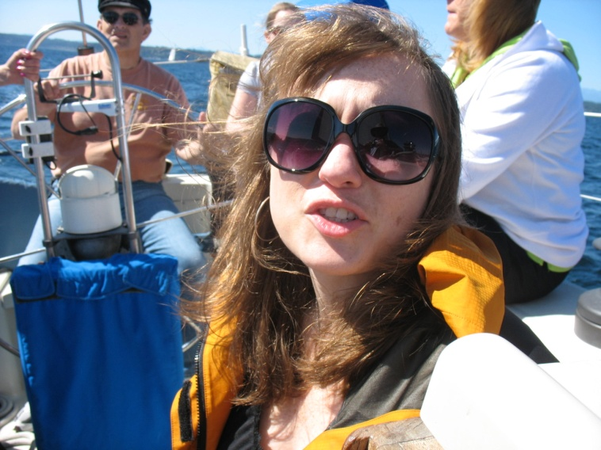
How Our Group Works
Read your selection (or have it read) out loud
Listen to others critiques
Thank participants for their input
Special stuff
    Quarterly retreats
    Group presentations
    Social events

Slide 12
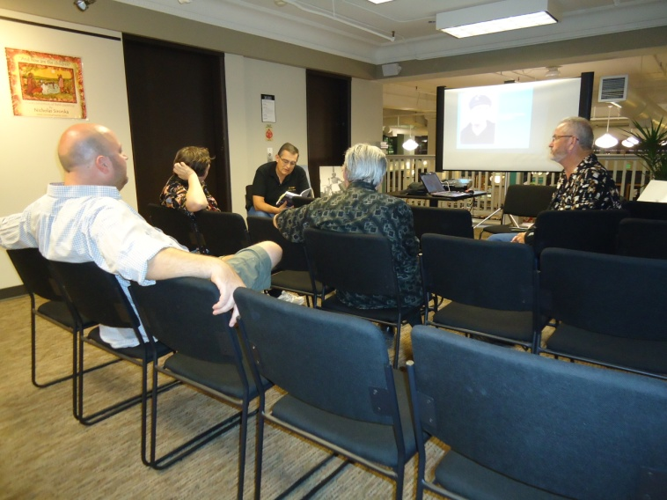
How to Critique
The purpose of critique is to provide useful information and feedback without deflating the writer’s ego
Be helpful and inspiring
Use sandwich technique
Tell what works and what doesn’t

Slide 13
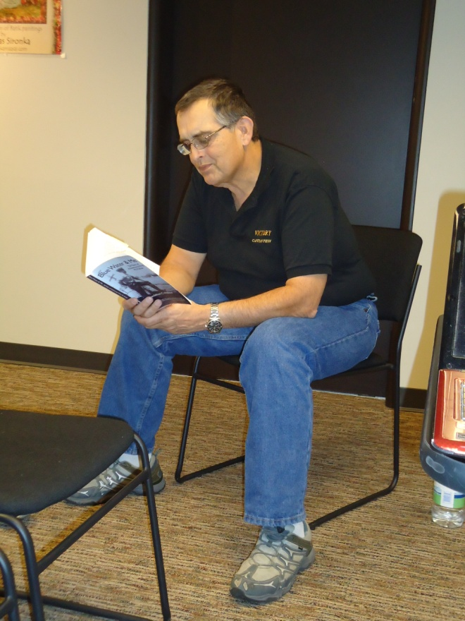
How to Critique
Keep an open mind
Be honest
Take notes of comments on your manuscript
Make notes on other’s manuscripts
Tell how you reacted to piece, how it made you feel

Slide 14

Finding A Group
You may have to try several to find the one that’s right for you
Craig’s List
Meet up groups
Writers conferences
Create an eye-catching flyer
Post notices and run ads
Local online communities

Slide 15
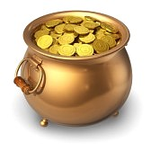
Finding A Group
Network
Join classes
Read writing publications and post notices there
Contact places that offer writing classes
  Community Colleges
  Parks & Recreation Departments
  Ask writing teachers to inform their students about your group.

Slide 16
Choosing A Group
How often do they meet?
How long are meetings?
How is critique handled?
Do you read your work in the group meeting?
Do you submit ahead of time or do critique in the meeting?
How many people in group?
Level of experience writing?
Where does the group meet?

Slide 17
Choosing A Group
Make up of Group
Logistics-decisions to make
Running a group
What you’ll do when you meet
Handling Manuscripts-Decisions To Make
  Number of words/pages
  How much time for each member
  Read aloud or silently
  Read in advance
  Timekeeper

Slide 18
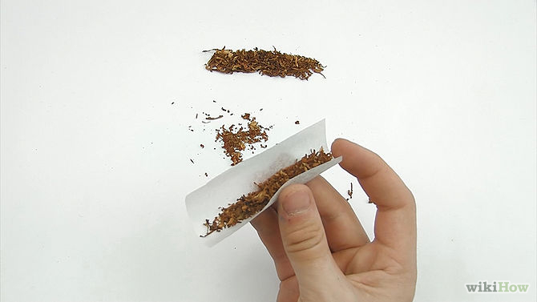
Roll Your Own
Ask for writing samples
Meet and talk in informal atmosphere before asking to do critiques
Agree to rules up front – put them in writing
Start small and add a person or two at a time
Audition new members – they come as “guests writers”

Slide 19

Dealing With Personality Conflicts
Don’t let one person destroy your group
Is this just your problem or is everyone else in group bothered?
Take person aside and give them feedback
When all else fails, ask them to leave the group

Slide 20
Tips For Sucess
Be a Considerate Member
Read Aloud
Bring copies
Set a time Limit and a time keeper if needed
Keep the group small
Ask what the author wants from the critique
Require a commitment
Keep an open mind
Do not take criticism personally
Don’t be defensive
It’s up to the writer to decide what advice he/she will take
Sometimes, when several people have the same reaction, you need to listen

Slide 21
Stick With It
When you don’t feel like going—go anyway! You never know when your muse will appear.
If you don’t have anything to present—go anyway! Sometimes you get as much or more from critiquing others.
When you shouldn’t go-- If you have had such a rough week/month that you know you will only feel like venting your frustrations on others, stay home.

Slide 22

Thank You
I’d love to help you set up your group in San Diego area
Questions?
Comments
www.pennwallace.com

